Slide 1
Tableau Fundamentals
Exploring Tableau Terminology
[Instructor Name]
[Additional Description]

Slide 2
How to teach this slide deck
This slide deck covers an overview of Tableau and highlights key terminology. Each slide includes notes that cover information about the topic and sample walkthroughs. Use these notes to expand on each slide. It is recommended that you open Tableau and walk through each topic to provide visual examples.
For this slide deck, you can use the sample workbook titled World Indicators. This is available when you start Tableau. A sample walkthrough assignment is also included in the exercise files. Students can use this as a supplementary learning to this deck.
If you have any further questions regarding this content, please reach out to tft@tableau.com

Slide 3
Agenda
Where we are going
Introduction to Desktop and Desktop Workflow
The Tableau Platform
Application Terminology
Visual Cues for Fields
Elements of a Visualization
Workbook Types
Notes:
As you teach this slide demonstrate:
The Tableau platform and general terminology.
How Tableau uses colors for visual cues.
What the Tableau workflow is and the anatomy of a visualization.

Slide 4
Exploring the Tableau Platform
How to get started
Tableau Desktop starts with connecting to a data source.
Tableau Desktop provides many data options to connect to through the Connect Pane.
Search for Data - Connection to an external Tableau Server
To a File - Connection to local files including PDF, CSV, TXT and Microsoft Excel
To a Server - Connection to popular database servers including Redshift, Oracle,DB2, SQL Server
Saved Data Sources - Connection to packaged Tableau data sources
Notes:
As you teach this slide demonstrate:
How Tableau starts with a data source and that Tableau can connect to all types of data.
Below are examples of each type. Feel free to add these to the slide deck. This content is included in the external content file and the lms import.
Follow along exercise
Ask Students to open Tableau
On the connect menu, ask student to click through the different options
Select the microsoft excel option from the file section
Open the excel file (sampleData.xls) in the week 1 exercise files

Slide 5
Tableau File Types
Several different file types are used within Tableau
Workbooks (.twb) - Hold one or more worksheets or dashboards. These do not include the data.
Bookmarks (.tbm) - Contain a single worksheet and are easy to share your work.
Packaged Workbooks (.twbx) - Contain the workbook along with any other supporting data or images.
Extract (.hyper or .tde) - Local copy of a subset or entire data that you can use to share with others.
Data Source (.tds) - Shortcut for quickly connecting to the data. These files do not contain the actual data but rather the information to connect.
Packaged Data Source (.tdsx) - Contains the data source file as well as any local file data.
Notes:
As you teach this slide demonstrate:
The different file type extensions Tableau use.
The main difference is between the files types.
What is included in some but not others?

Slide 6
Exploring the Tableau Platform
How to get started
After connecting to a data source, use the data source page to explore and customize the data.
Using this pane, you can
View the connected data source
Create relationships between your tables
Create joins and unions between tables
View the top 1,000 rows of your data
View the metadata of your data source

Slide 7
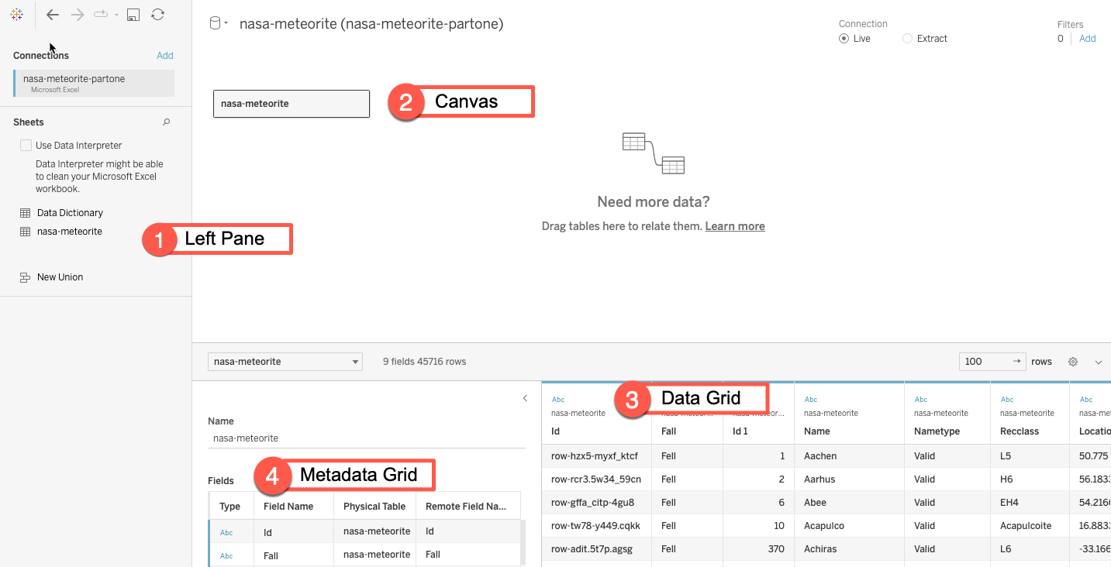
Exploring the Tableau Platform
Notes:
On this slide demonstrate:
The different parts of the data source.
Highlight each of the 4 major areas detailed below.
The Tableau Website further expands on the 4 sections.
Left pane - Displays location of data source and logical tables brought in from the data source.
Canvas - The logical and Physical layer where you can build relationships between your data.
Data grid - Displays the first 1,000 rows of your data source. Using the grid, you can edit your data including types, groups and aliases
Metadata grid - Displays the fields in your data source as row. Using this grid, you can change a fields data type and name.

Slide 8
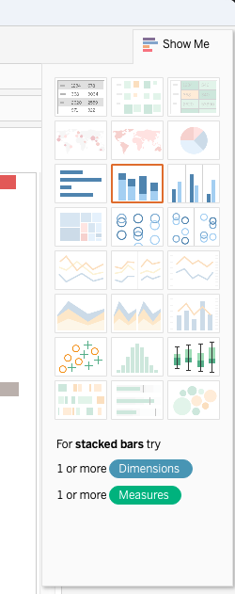
Exploring the Tableau Platform
How to get started
After setting up a data source, creating a new sheet provides options to visualize the data.
Dragging dimension and measures to the view provides different visualization options.
Using the Show Me feature, requirements for different views are explained.
Notes:
On this slide Demonstrate:
How to create a new sheet
How dimensions and measures can be added to a view to create a simple bar graph.
How the Show Me menu works and additional view options are available.

Slide 9
Tableau Terminology
Important key features of Tableau
Cards and Shelves - Area surrounding the view. Data is placed here to created the structure of your visualization.
Shelve examples in Tableau include:
Rows
Columns
Filters
Card Examples in Tableau include:
Marks
Legends
Pages
Tooltip
Notes:
As you teach this slide demonstrate:
Where cards and shelves are located in Tableau.
How rows, columns and filters shelves work in Tableau.
What happens when you drag what to what?
How the marks card works and why it's important to the overall visualization.
Use this Tableau Help article as a guide.

Slide 10
Tableau Terminology
Important key features of Tableau
Toolbar and Navigation menu - This area is used to access command and analysis.
View - The canvas where the visualization is displayed. This area is surrounded by the cards and shelves.
Marks - The data displayed on the view. These can be displayed in many different visualization types.
Sidebar - Location of the data pane and analytics pane.

Slide 11
Tableau Terminology
Important key features of Tableau
Data pane - Display of data source connections and available data fields.
Analytics pane - Quick access to analytics available for your view.
Data Source - Provides access to data source fields to be used in the workbook.
Status Bar - Located at the bottom of the Tableau workspace. Displays descriptions of menu items as well as information about the current view.

Slide 12
Visual Cues in Tableau
Icons and color used in Tableau
Tableau uses visual cues to explain types and state of data used in the workbook.
Visual cues are used in different locations throughout the workbook.
Data Sources - Different color check marks are used to differentiate between primary and secondary data sources.
Data Fields - Different icons and colors are used to represent different data types.
Field Shelves - Fields on the shelf use icons, colors, and text to represent different data types.
Notes:
As you teach this slide demonstrate:
How Tableau uses different visual cues to further explain the type of data.
How primary and secondary data sources are indicated. You can expand on the different icons based on the type of data being used.
How different types have different icons on the data pane.
When added to a shelf, explain how data is represented.
How data on the marks card represented differently.
Different fields on the calculation editor appear differently
Additional details on the what type of visual cues are available on the Tableau Help (https://help.tableau.com/current/pro/desktop/en-us/tips_visualcues.htm).

Slide 13
Elements of a Visualization
Dimensions, Measures, and Marks are combined to create different charts to visualize data.
Dimensions are qualitative values such as names and dates.
Measures are numeric, quantitative values you can measure.
Marks are the data points displayed on the view using:
Color
Size
Shape
Tooltip
Notes:
As you teach this slide demonstrate:
How Dimensions, Measures and Marks are the foundation of a visualization.
How adding Dimensions and measures to the shelves will create different charts.
The following slides will go into specific chart types.
In Class Activity:
Open one of the sample data sets provided by Tableau
Create a new sheet and use the data to create different charts.

Slide 14
Questions?

